Slide 1
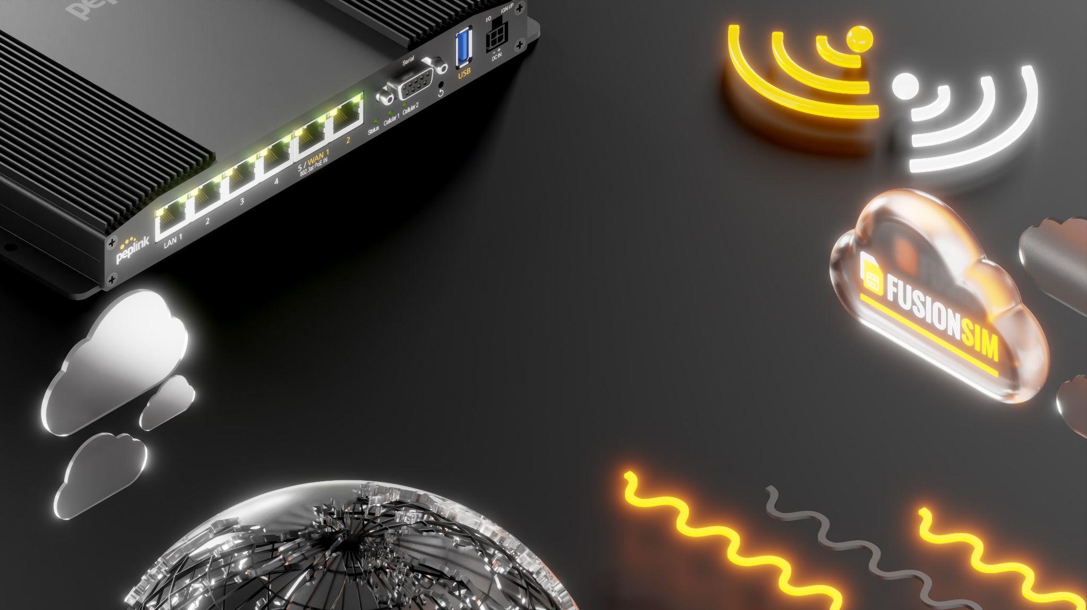

FusionSIM
Exploring the Possibilities

Slide 2
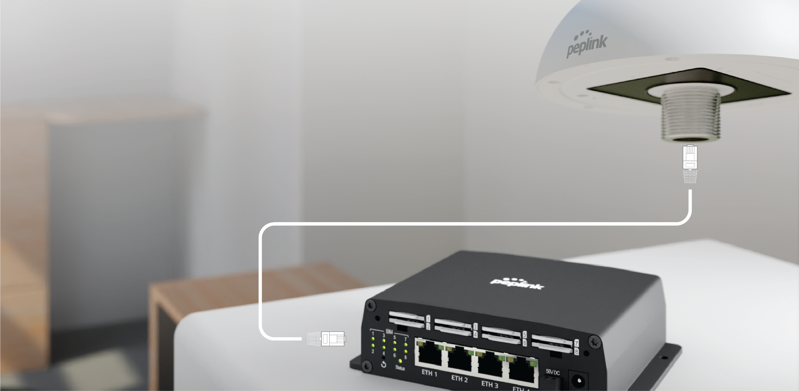



RemoteSIM Technology (SIM Injector)
RemoteSIM Technology
Via Ethernet Cables
Simplified Maintenance
And Management
HD1 Dome Pro
Deployed Outdoors
SIM Injector
Used Indoors
Notes:
RemoteSIM technology allows SIM cards to the device via the Ethernet cable. The SIM card now longer needs to be inserted into the device Physically.
For certain industries and scenarios this helps a lot to simplify the maintenance and also allows the use more SIM card options.
We decided to go one step further and improve the RemoteSIM technology by allowing us to provide SIM cards to the device from distant locations.

Slide 3





RemoteSIM Technology (SIM Injector)
Notes:
With the addition of the SIM Injector, the HD1 Dome can support up to 10 SIM. Simply connect an Ethernet cable between the SIM Injector and the HD1 Dome. The SIM Injector is capable of PoE output, so you don’t need to add another PoE switch to your deployment.

Slide 4
One Step Further - FusionSIM
Provide SIM cards to the device from distant locations.
Notes:
We decided to go one step further and improve the RemoteSIM technology by allowing us to provide SIM cards to the device from distant locations.

Slide 5
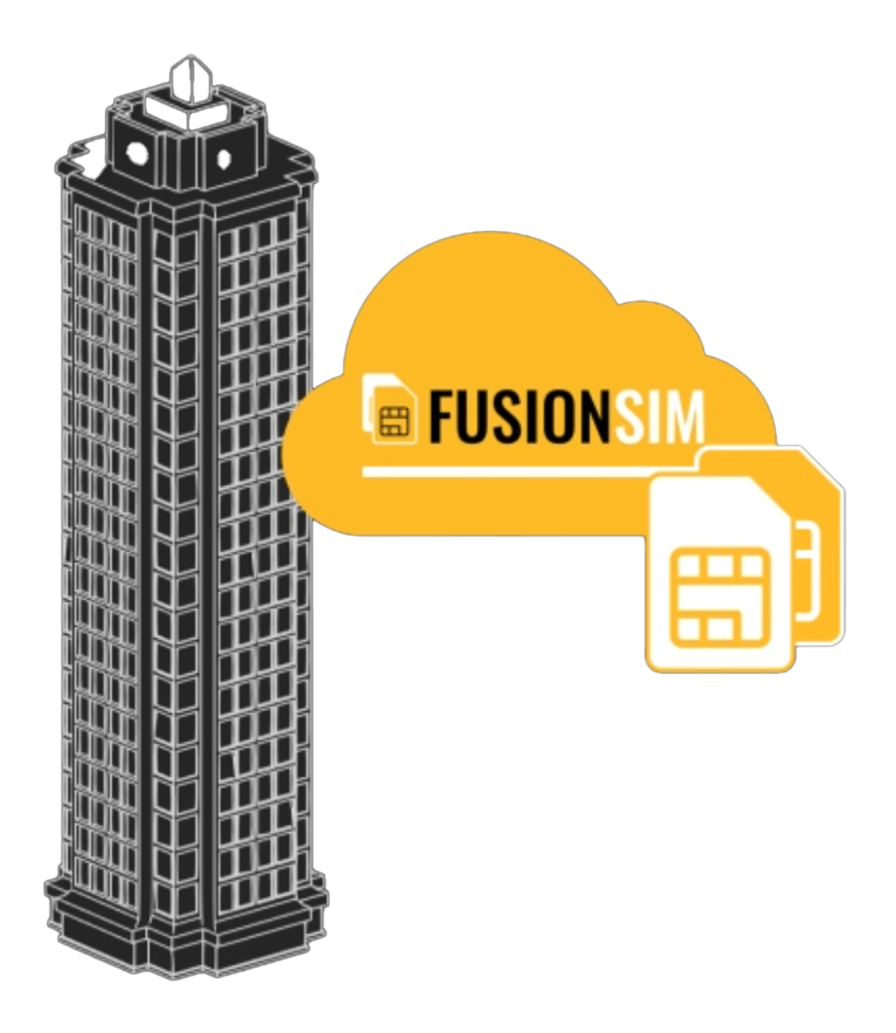






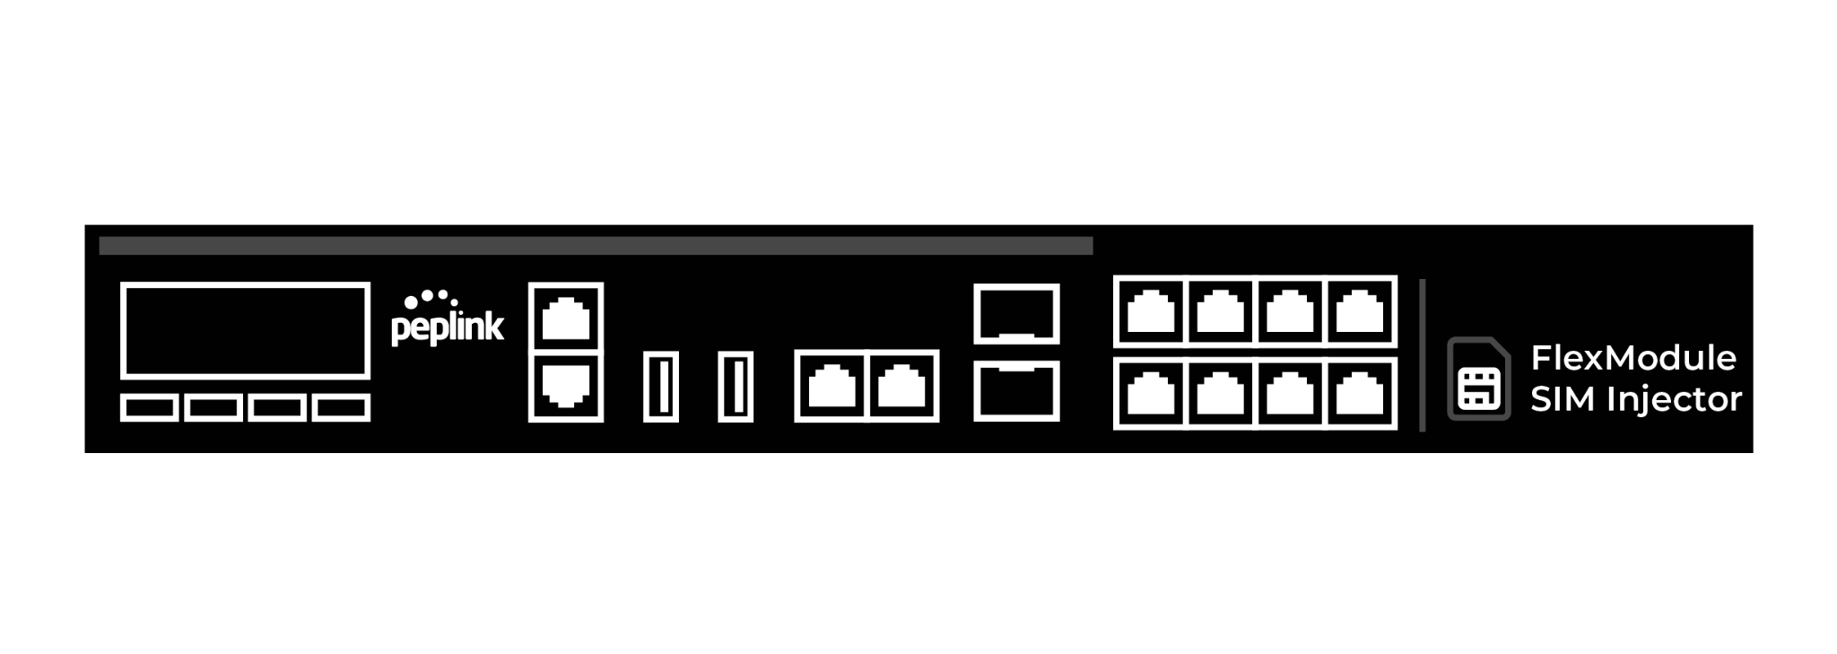
RemoteSIM Technology (FusionSIM)

Slide 6
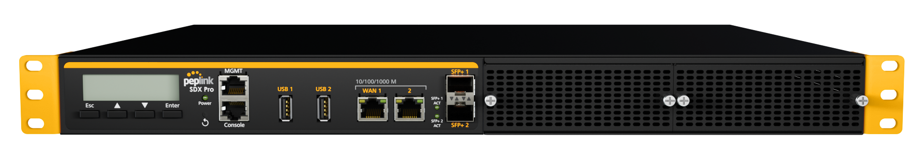
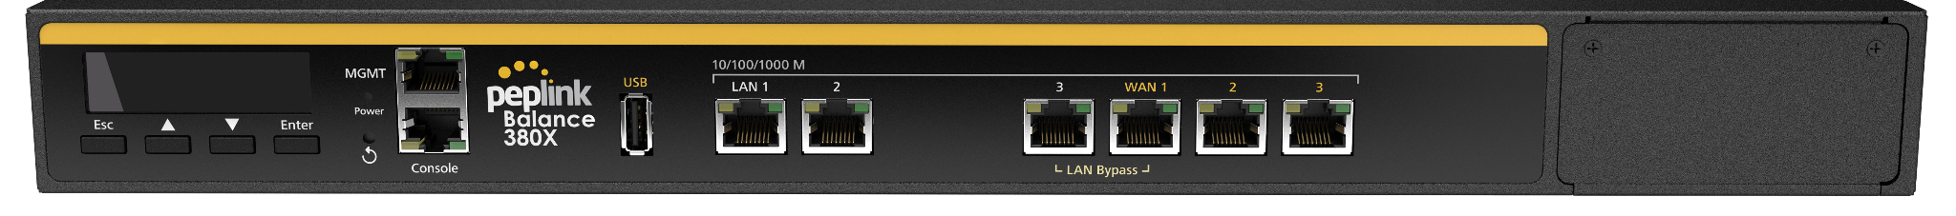

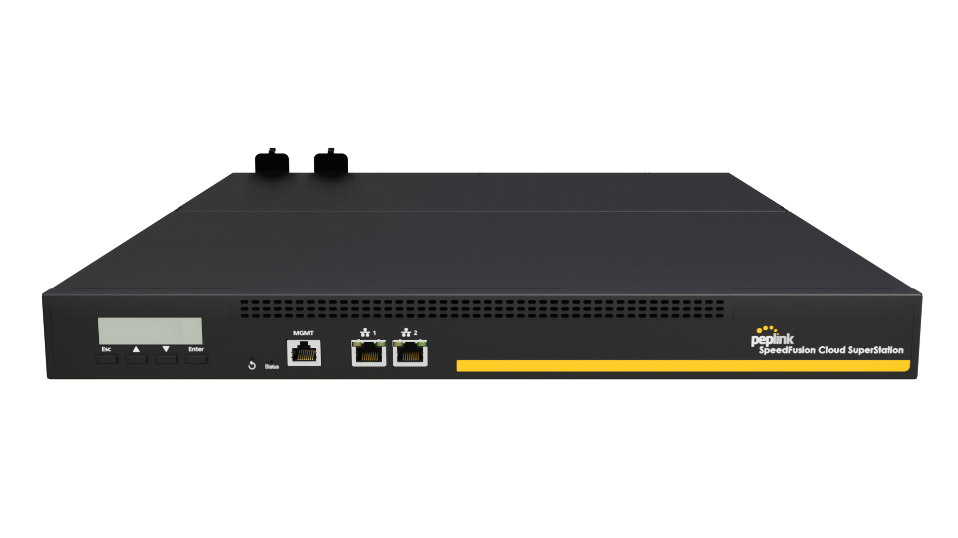
FusionSIM - FusionSIM Platform
8
56
112
448
Notes:
Peplink-developed technology that enables virtual and remote SIM management. In order to deploy this technology, customers will need these components: FusionSIM Platform, FusionSIM Controller, and FusionSIM Devices.
SFC SIM Nodes are FusionSIM Platforms intended for managed services providers to build or improve their own managed services with FusionSIM technology. Consists of:
● SFC SIM Nodes - FusionSIM platforms with SIM card capacity ranging from 8 / 56 / 112 SIMs, or the SFC Superstation which holds up to 448 SIMs
● Valid FusionSIM Controller license (License required per SFC SIM Node) SFC SIM Nodes have a dual function of hosting an other end point as well as acting as a FusionSIM platform.

Slide 7
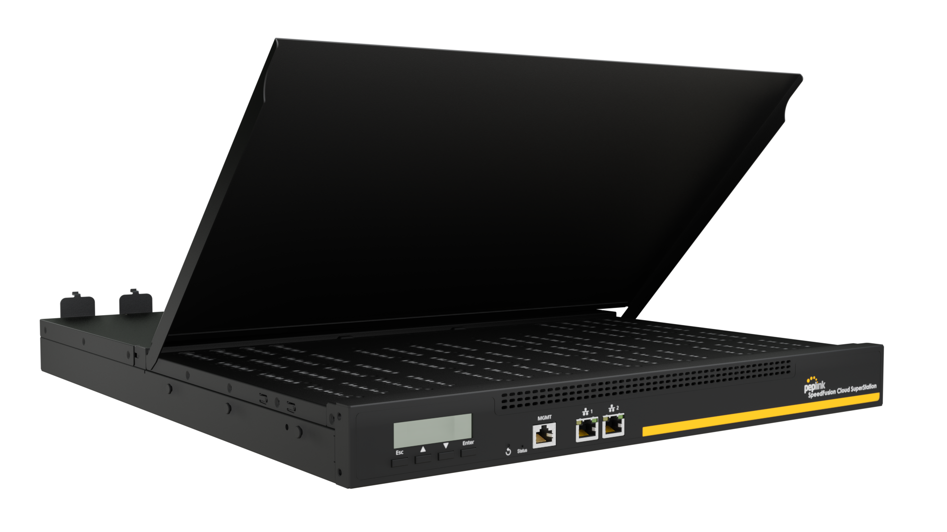
SpeedFusion S Node SuperStation (448 SIMs)

Slide 8
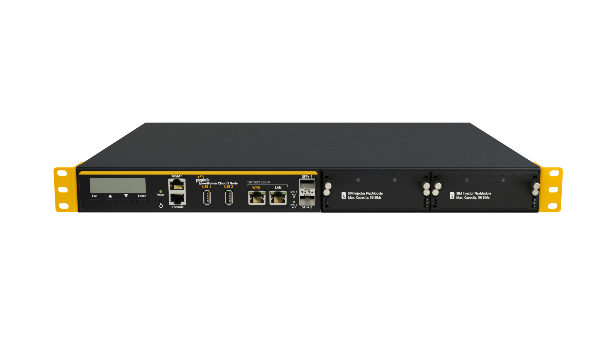
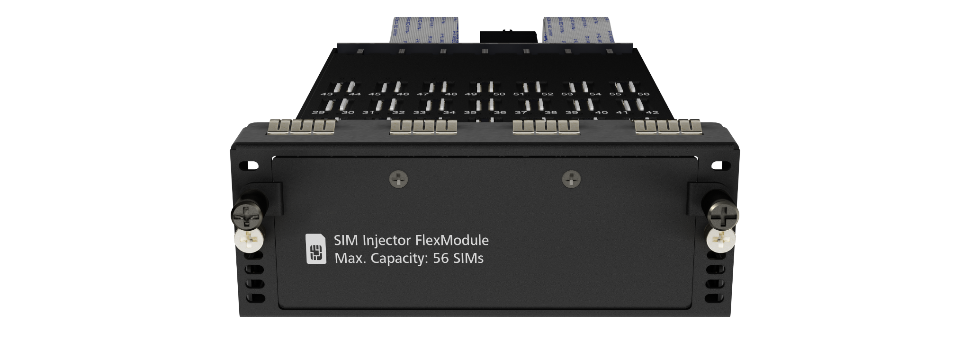
SpeedFusion S Node (112 SIMs)
Notes:
Peplink-developed technology that enables virtual and remote SIM management. In order to deploy this technology, customers will need these components: FusionSIM Platform, FusionSIM Controller, and FusionSIM Devices.

Slide 9
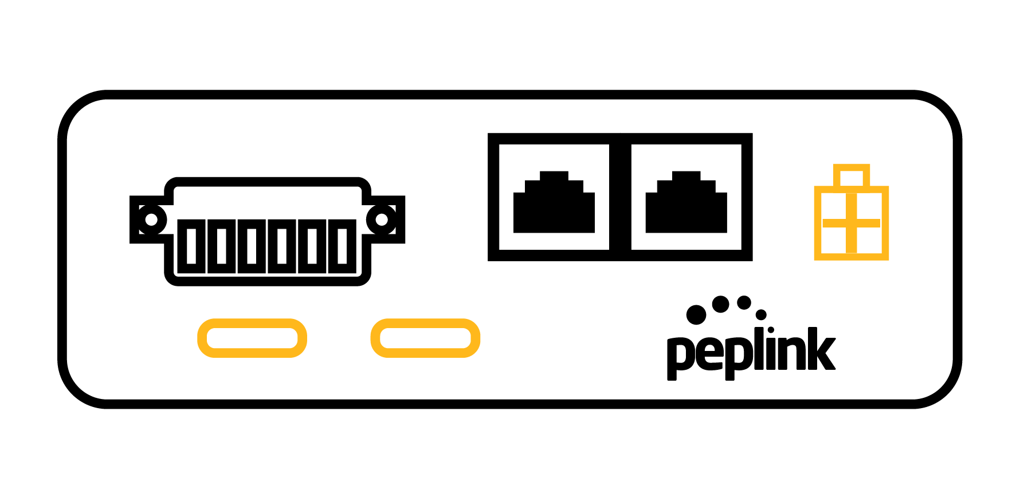

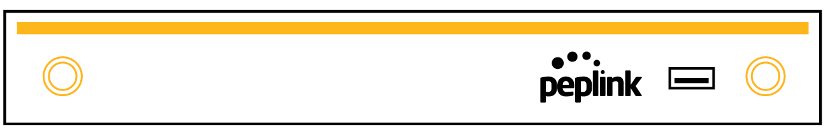


FusionSIM Structure
FusionSIM Devices
FusionSIM Controller
FusionSIM Platform
Peplink routers with FusionSIM technology.
Cloud-based user interface to define rules.
Where SIM cards are physically deposited.
……

Slide 10
How does it work?
1
FusionSIM devices connect to
FusionSIM Controller and ask for a SIM card.
2
The Controller sends an appropriate SIM profile to the requesting device.
3
Device connects to FusionSIM platform to get a SIM card.
ISP 1
ISP 2
ISP 3
ISP 4
……

Slide 11

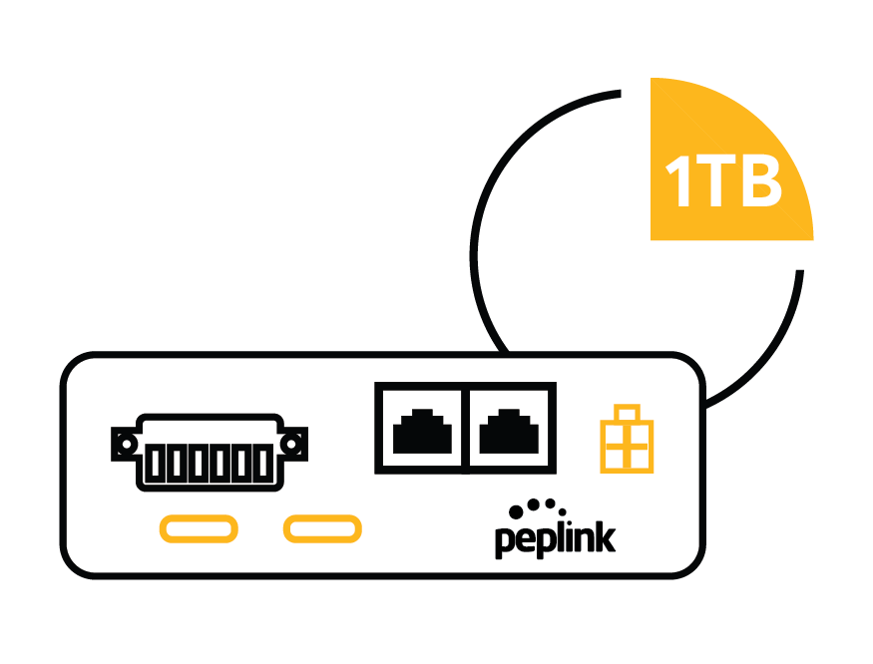

One Step Further - FusionSIM
Instant Flexibility
FusionSIM gives MSPs the ability to remotely manage and provision their SIM cards into their CPEs
Practical Uses:
Remote SIM card maintenance
Lower connectivity cost when travelling
No data limits caps with multiple SIM cards
Eliminate pre-deployment site surveys
New Opportunities
New service option for partners: Router + connectivity solution
Lower Cost
The Best network achieved with the lowest cost.

Slide 12
FusionSIM - Mechanism
Notes:
We decided to go one step further and improve the RemoteSIM technology by allowing us to provide SIM cards to the device from distant locations.

Slide 13









Subscription
Distribution Rule
SIM Contract
SIM Card
FusionSIM Mechanism
★ Establish Internet Connection
A WAN connection that the FS device can use to reach the FusionSIM Controller. Can be landline, cellular, starlink, usb modem …….Latency <150ms is recommended.
Notes:
FusionSIM Devices
Peplink routers that support FusionSIM technology.
FusionSIM Controller
Cloud-based user interface where SIM card priorities are assigned, and rules are defined to govern how to allocate SIM cards. It also reports status of SIM pool in the FusionSIM Infrastructure.
FusionSIM Platform
FusionSIM Platform is where multiple physical SIMs are deposited. The deposited physical SIMs can then be virtually or remotely injected into FusionSIM Devices within the user’s organization.

Slide 14

Subscription
Distribution Rule
SIM Contract
SIM Card
FusionSIM Mechanism
★ Establish Internet Connection
A WAN connection that the FS device can use to reach the FusionSIM Controller. Can be landline, cellular, starlink …….
FusionSIM Platform
8
Modem A
Modem B
Notes:
FusionSIM Devices
Peplink routers that support FusionSIM technology.
FusionSIM Controller
Cloud-based user interface where SIM card priorities are assigned, and rules are defined to govern how to allocate SIM cards. It also reports status of SIM pool in the FusionSIM Infrastructure.
FusionSIM Platform
FusionSIM Platform is where multiple physical SIMs are deposited. The deposited physical SIMs can then be virtually or remotely injected into FusionSIM Devices within the user’s organization.

Slide 15
Subscription
Distribution Rule
SIM Contract
SIM Card
FusionSIM Mechanism (Dual-Cellular Router)
FusionSIM Platform
★ Injecting SIM into Modem B
8
Modem A
Modem B
Notes:
FusionSIM Devices
Peplink routers that support FusionSIM technology.
FusionSIM Controller
Cloud-based user interface where SIM card priorities are assigned, and rules are defined to govern how to allocate SIM cards. It also reports status of SIM pool in the FusionSIM Infrastructure.
FusionSIM Platform
FusionSIM Platform is where multiple physical SIMs are deposited. The deposited physical SIMs can then be virtually or remotely injected into FusionSIM Devices within the user’s organization.

Slide 16
Subscription
Distribution Rule
SIM Contract
SIM Card
FusionSIM Mechanism (Dual-Cellular Router)
FusionSIM Platform
8
Modem A
Modem B
Notes:
FusionSIM Devices
Peplink routers that support FusionSIM technology.
FusionSIM Controller
Cloud-based user interface where SIM card priorities are assigned, and rules are defined to govern how to allocate SIM cards. It also reports status of SIM pool in the FusionSIM Infrastructure.
FusionSIM Platform
FusionSIM Platform is where multiple physical SIMs are deposited. The deposited physical SIMs can then be virtually or remotely injected into FusionSIM Devices within the user’s organization.

Slide 17
Subscription
Distribution Rule
SIM Contract
SIM Card
FusionSIM Mechanism (Dual-Cellular Router)
FusionSIM Platform
★ Injecting SIM into Modem A
8
Modem A
Modem B
Notes:
FusionSIM Devices
Peplink routers that support FusionSIM technology.
FusionSIM Controller
Cloud-based user interface where SIM card priorities are assigned, and rules are defined to govern how to allocate SIM cards. It also reports status of SIM pool in the FusionSIM Infrastructure.
FusionSIM Platform
FusionSIM Platform is where multiple physical SIMs are deposited. The deposited physical SIMs can then be virtually or remotely injected into FusionSIM Devices within the user’s organization.

Slide 18

Subscription
Distribution Rule
SIM Contract
SIM Card
FusionSIM Mechanism (Dual-Cellular Router)
FusionSIM Platform
★ Injecting SIM into Modem A
8
Modem A
Modem B
Notes:
FusionSIM Devices
Peplink routers that support FusionSIM technology.
FusionSIM Controller
Cloud-based user interface where SIM card priorities are assigned, and rules are defined to govern how to allocate SIM cards. It also reports status of SIM pool in the FusionSIM Infrastructure.
FusionSIM Platform
FusionSIM Platform is where multiple physical SIMs are deposited. The deposited physical SIMs can then be virtually or remotely injected into FusionSIM Devices within the user’s organization.

Slide 19
Subscription
Distribution Rule
SIM Contract
SIM Card
FusionSIM Mechanism (Dual-Cellular Router)
Modem A
FusionSIM Platform
Active
SIM (SmartFren) - Fusion SIM
Standby
SIM (Telkomsel) - Physical SIM
Modem B
Active
SIM (XL Axiata) - Fusion SIM
8
Modem A
Modem B
Notes:
FusionSIM Devices
Peplink routers that support FusionSIM technology.
FusionSIM Controller
Cloud-based user interface where SIM card priorities are assigned, and rules are defined to govern how to allocate SIM cards. It also reports status of SIM pool in the FusionSIM Infrastructure.
FusionSIM Platform
FusionSIM Platform is where multiple physical SIMs are deposited. The deposited physical SIMs can then be virtually or remotely injected into FusionSIM Devices within the user’s organization.

Slide 20
Subscription
Distribution Rule
SIM Contract
SIM Card
FusionSIM Mechanism (Dual-Cellular Router)
Modem A
FusionSIM Platform
Active
SIM (SmartFren) - Fusion SIM
Standby
SIM (Telkomsel) - Physical SIM
Modem B
Active
SIM (XL Axiata) - Fusion SIM
8
Modem A
Modem B
Notes:
FusionSIM Devices
Peplink routers that support FusionSIM technology.
FusionSIM Controller
Cloud-based user interface where SIM card priorities are assigned, and rules are defined to govern how to allocate SIM cards. It also reports status of SIM pool in the FusionSIM Infrastructure.
FusionSIM Platform
FusionSIM Platform is where multiple physical SIMs are deposited. The deposited physical SIMs can then be virtually or remotely injected into FusionSIM Devices within the user’s organization.

Slide 21
FusionSIM Structure
FusionSIM Controller
……
FusionSIM Devices
Subscription
Distribution Rule
SIM Contract
SIM Card
FusionSIM Platform
Notes:
FusionSIM Devices
Peplink routers that support FusionSIM technology.
FusionSIM Controller
Cloud-based user interface where SIM card priorities are assigned, and rules are defined to govern how to allocate SIM cards. It also reports status of SIM pool in the FusionSIM Infrastructure.
FusionSIM Platform
FusionSIM Platform is where multiple physical SIMs are deposited. The deposited physical SIMs can then be virtually or remotely injected into FusionSIM Devices within the user’s organization.

Slide 22
FusionSIM Controller
Device
Subscription (10GB)
Distribution Rule (Telkomsel)
FusionSIM Controller
Contract 1
Contract 2
SIM
SIM
FusionSIM Platform

Slide 23
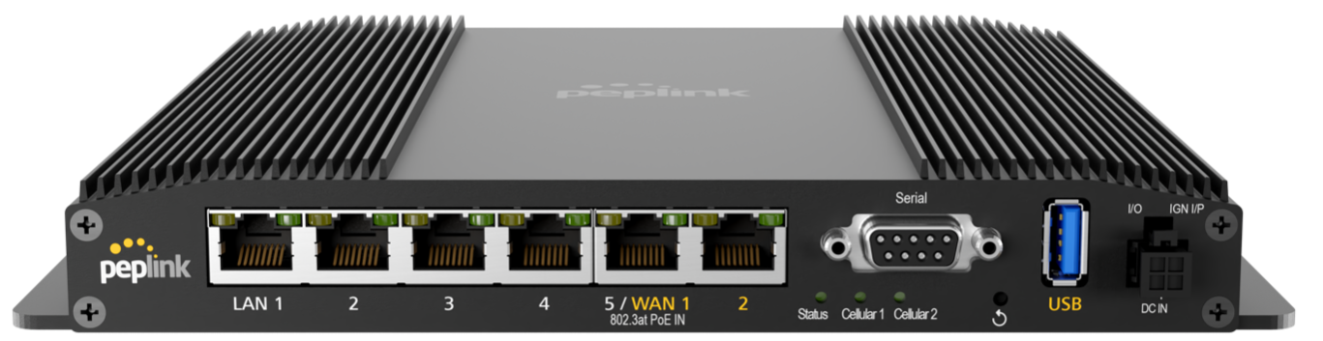






Prioritizing SIM Selection Options
Device
A
Subscription
10GB/month
B
Distribution
Rule A
Distribution
Rule B
Distribution
Rule C
Contract
(XL Axiata)
Contract
(XL Axiata)
Contract
(XL Axiata)
C

Slide 24
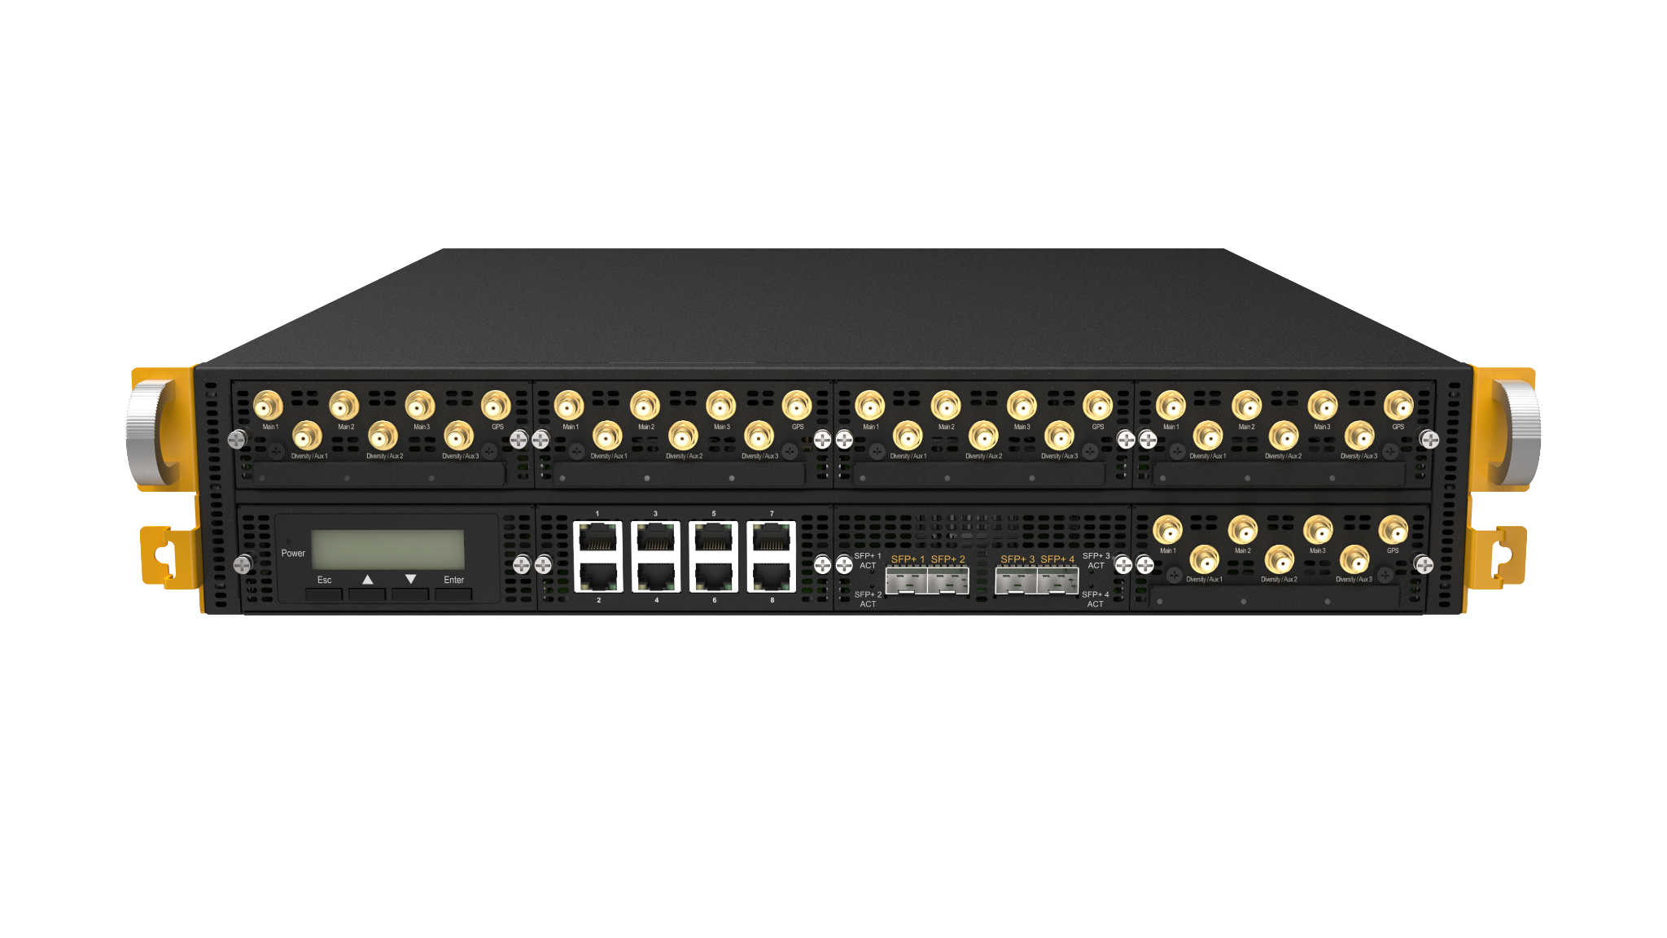
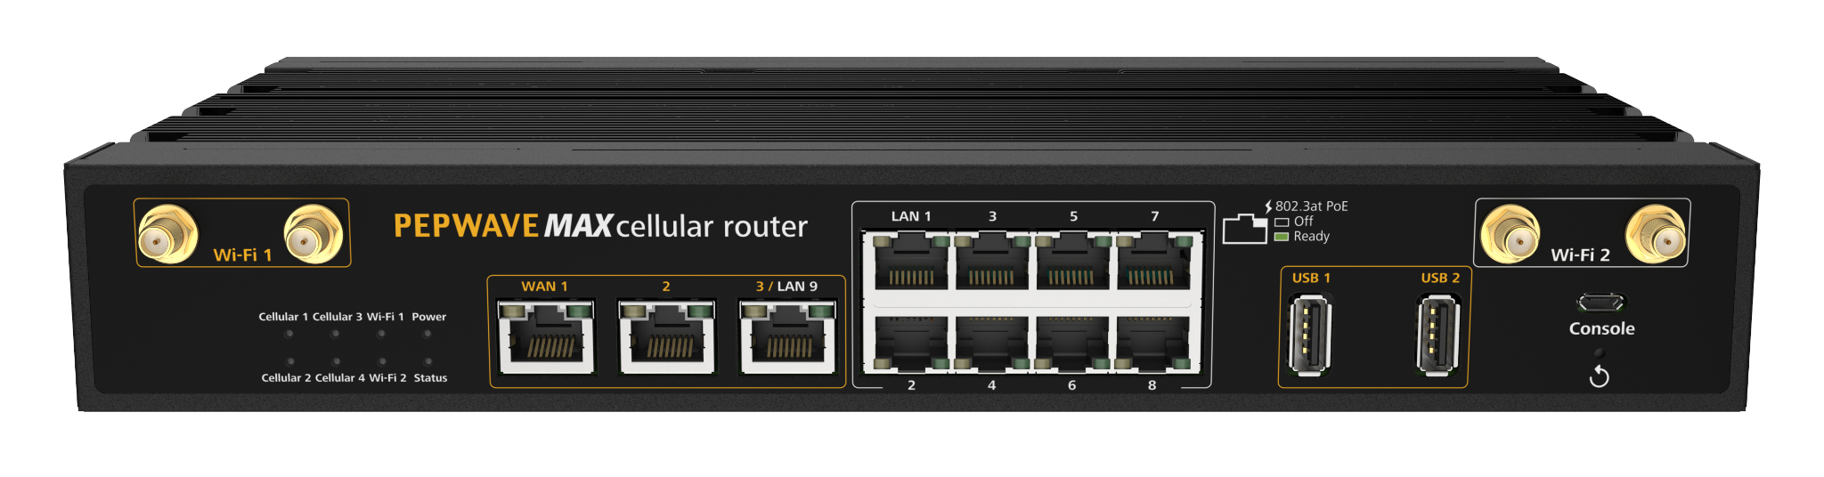
FusionSIM Devices
Balance Series
MAX Series
Current models:
  MBX / MBX 5G / MBX Mini
  PDX
  BR1 Classic (HW 3) / ESN / IP55 (HW 4 or above) / Pro (HW 5/6)
  HD2 Mini (SKU: MAX-HD2-MINI-XXXX-RM-T) / Dome
  UBR LTE / Plus
  SFE (HW 2 or above)
  SFE CAM
  Transit Core / Pro / Pro E
  BR2 Pro
Upcoming models: HD2 Dome Pro E
* with FlexModule Mini:
EXM-MINI-1LTEA-W,
EXM-MINI-1LTEA-P,
EXM-MINI-1LTEA-R,
EXM-MINI-1LTEA-K or
EXM-MINI-1GLTE-G
20X*
310 5G
310 Fiber 5G
310X
310X 5G
380X*
580X*
SDX Pro^
EPX^
^ with FlexModule Plus:
EXM-3LTEA-W,
EXM-3LTEA-P,
EXM-3LTEA-R,
EXM-3LTEA-K,
EXM-2GLTE-G
EXM-2X5G
20X*, 310 5G, 310 Fiber 5G, 310X, 310X 5G, 380X*, 580X*, SDX Pro^, EPX^
* with FlexModule Mini EXM-MINI-1LTEA-W, EXM-MINI-1LTEA-P, EXM-MINI-1LTEA-R, EXM-MINI-1LTEA-K or EXM-MINI-1GLTE-G
^ with FlexModule Plus EXM-3LTEA-W, EXM-3LTEA-P, EXM-3LTEA-R, EXM-3LTEA-K, EXM-2GLTE-G or EXM-2X5G
Current models: MBX, MBX 5G, MBX Mini, PDX, BR1 Classic (HW 3), BR1 ESN, BR1 IP55 (HW 4 or above), BR1 Pro (HW 5/6), HD2 Mini (SKU: MAX-HD2-MINI-XXXX-RM-T), HD2 Dome, UBR LTE, SFE (HW 2 or above), SFE CAM, Transit Core, Transit Pro E, Transit Pro, BR2 Pro, UBR Plus
Upcoming models: HD2 Dome Pro E
Notes:
Use USB modem as Lighter connection? Yes, it can be used. In general any internet connection can be used as a lighter as long as it’s latency is <150ms.
Why Max adapter does not support FusionSIM? Max adapter is single cellular modem. If the only source for Lighter connection is LTE/5G, then need to have at least 2x cellular modems.
Can be used as an USB expansion
Why BR1 Classic, BR1 ESN, BR1 IP55, BR1 Pro these are single cellular, how can they support FusionSIM? For lighter connection the device can use Ethernet as well. However, I am not sure if BR1 Classic support FusionSIM. As I remember it doesn’t.

Slide 25





Plugging in to SpeedFusion Ecosystem
FusionSIM Platform
FusionSIM Controller
Branches
SpeedFusion Tunnels
InControl2
OR
OR

Slide 26
Deployment
Examples

Slide 27


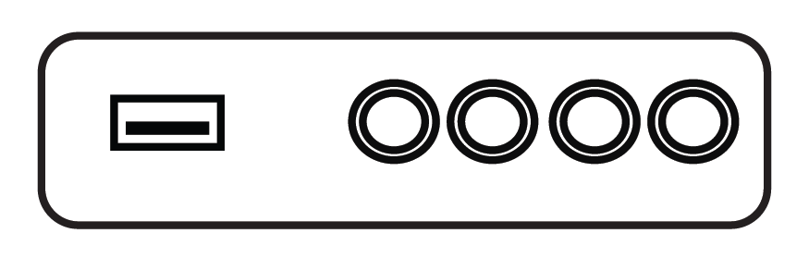

Connectivity for Maritime
Without FusionSIM
With FusionSIM
Country A
Territorial Sea
Country B
Territorial Sea
Country A
Territorial Sea
Country B
Territorial Sea
Internet
Internet
SDX Pro
LTE
SIM 1
SIM 2
Global Roaming
LTE 1
LTE 2
Global SIM
MAX HD2 MBX
Global SIM

Slide 28
Connectivity for Branches - Traditional
50× Business Data Plan /
Broadband (ISP- B)
on standby for failover at each site.
50 Routers
Broadband (ISP- A)
WAN 1A
WAN 1B
Broadband (ISP- B)
WAN 2A
WAN 2B
WAN 3A
WAN 3B
Internet
WAN 4A
WAN 4B
……
WAN 50A
WAN 50B

Slide 29
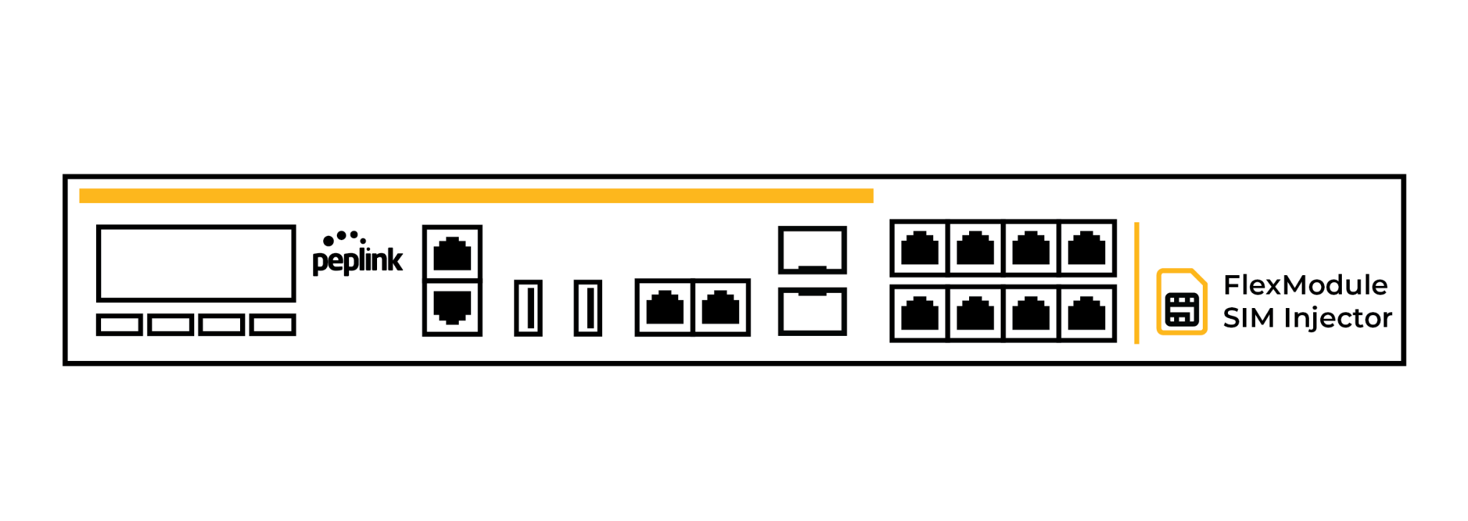

Connectivity for Branches with Fusion SIM
Broadband
50x Balance 20X
SDX Pro with FlexModule SIM Injector
WAN 1
5×SIMs on standby, only allocated to designated routers when necessary.
WAN 2
WAN 3
Internet
WAN 4
LTE 1
SIM 1
……
WAN 50
LTE 2
SIM 2

Slide 30


Failover SIM Pool for Enterprise
ISP A
ISP B
ISP A
FusionSIM
Typical setup
50 primary WAN
5 standby SIM
FusionSIM equipment & license
50 primary WAN
50 standby WAN
Limits carrier choices
Contract bound

Slide 31

FusionSIM Platform for MSP
8
56
56
FusionSIM Hardware
56
448
FSC Subscription (3 months / annually)
8 SIMs
56 SIMs
112 SIMs
448 SIMs
FusionSIM License (Fixed)
FusionSIM Hardware Care Plan

Slide 32
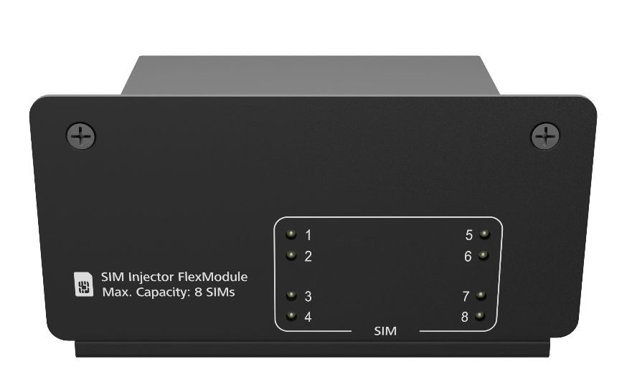
FusionSIM Platform for Enterprise
+
FusionSIM Hardware
B380X
8
+
SDX Pro
56
112
FusionSIM License (Variable)
Enabled SIM Limit × ($month/active SIM)
FusionSIM Hardware Care Plan

Slide 33






Stay CONNECTED with
Q & A
www.peplink.com
Peplink
Peplink | Pepwave
Peplink
peplink
Peplink Community

